Slide 1
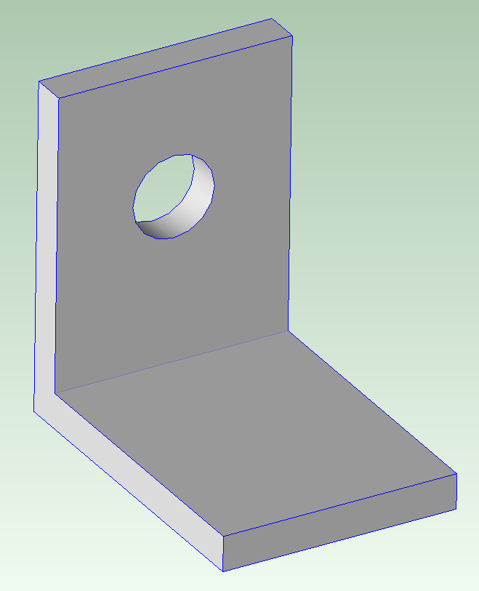
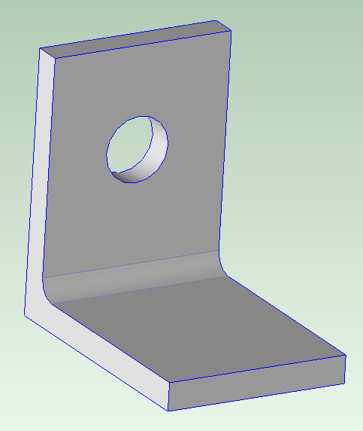
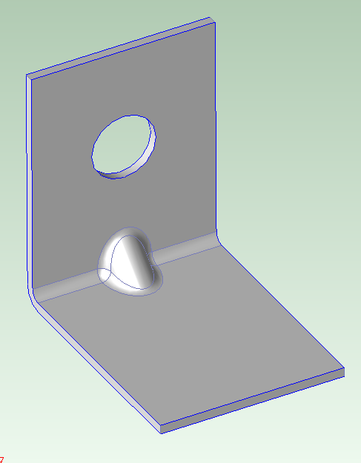
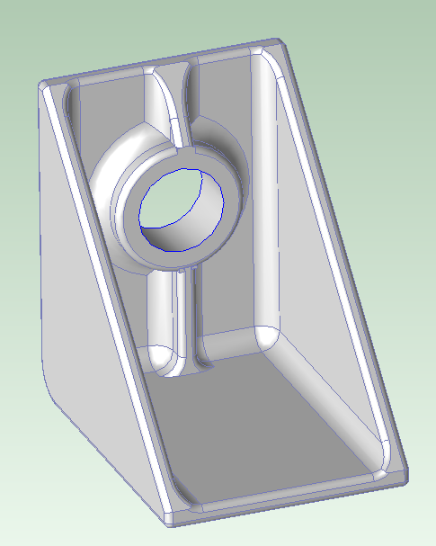
Lecture Class Slide Presentation 4-16-2020
This is the last class of actual lecture material, however, for the last class of semester (Tuesday May 5th), I will be announcing the “3 Best Teams” following assessment of your presentations by myself, TAs, and graders. The winning team members will receive an “Outstanding Achievement Award for Excellence in Engineering Design” from the department along with a certificate signed by the department heads, and myself, of course. I will include the 3 winning presentation ppt slides in my class presentation; so, please join the class, recognize the winners (and perhaps even send them a congratulatory email), and review their winning lecture presentation slides at that time ☺.
This week in class we will finish going through the “Design for Manufacture” notes. You may recall we covered the first 2 topics – Plastic Molding and Sheet Metal during the last lecture.
As I mentioned on Tuesday, unfortunately I have not been able to get you remote access to aPriori so we will have to dispense with aPriori cost estimates for your projects. I do, however, want you to understand the aPriori process and how it may be used to guide your design work, as well as help make vital design decisions. You will be using it in ME270, for those of you in the MechSE program.
So, I will end the presentation by going through the final Lecture Class Assignment (#15) with screen shots from aPriori, that you may use to complete the assignment. We will review 4 different ways we might design a simple bracket for different potential material and manufacturing process choices. The 4 geometries are shown below.
Bar stock
Angle Iron stock
Sheet Metal
Injection molded
Don’t forget to submit the lecture class assignment by the due date for full credit (i.e. April 19th, 8pm)

Slide 2
An Introduction to Design for Manufacture (DFM) Instructor: Mike L. Philpott mphilpot@illinois.edu
ME170
CAD
and our core manufacturing processes:
Plastic Molding
Sheet Metal
Rapid Prototyping/3D Printing
Bar & Tube Fabrication
Metal Casting
Machining
Covering these today

Slide 3
Primary Metal Casting Processes
Die Casting
Sand Casting
Permanent Mold Casting
Investment Casting

Slide 4
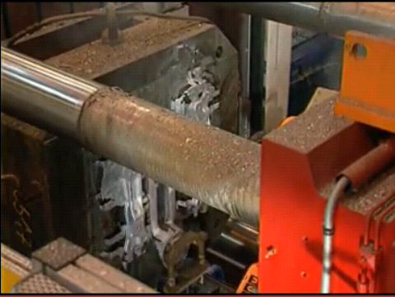
Die Casting
A non-ferrous metal is injected into a metal mold cavity under high pressure
Pressure is maintained during solidification, then mold is opened and part is removed, often by robotic manipulator
Use of high pressure to force metal into die cavity achieves high production rates
Die Casting Animation Video Clip

Slide 5
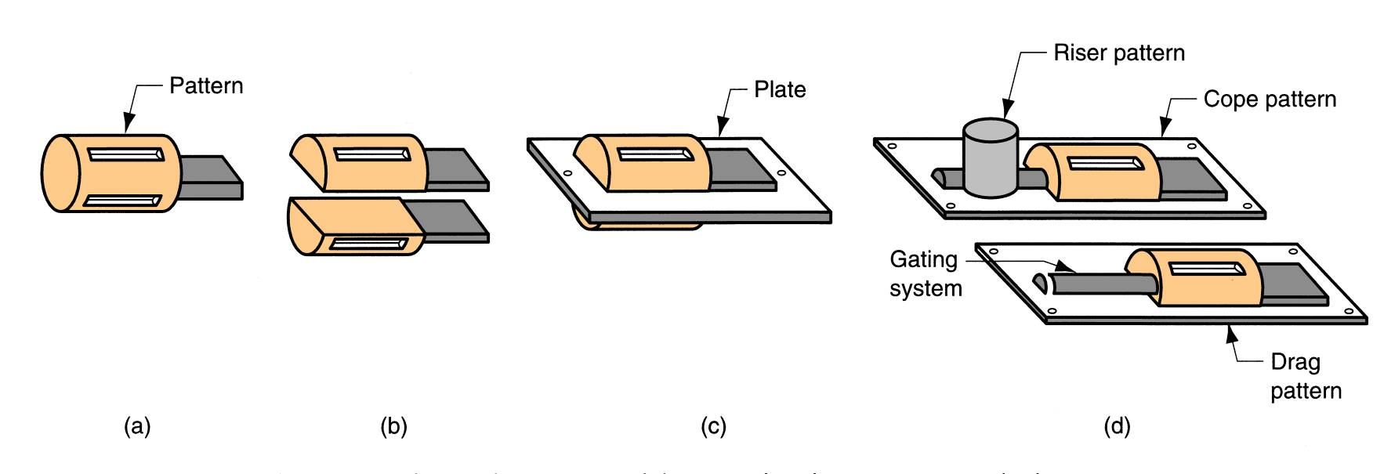
Sand Casting – Patterns required
Pattern – a model of the part, slightly enlarged to account for shrinkage and machining allowances
Types of patterns used in sand casting:
(a) solid pattern, (b) split pattern, (c) match‑plate pattern
(d) cope and drag pattern

Slide 6
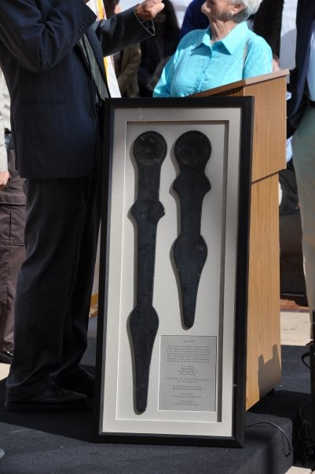
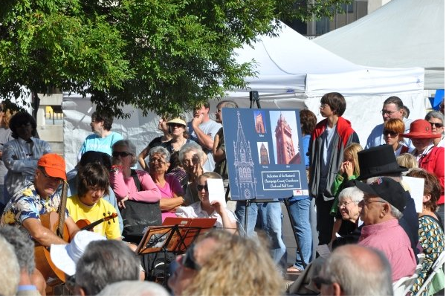
Urbana Courthouse Clock Tower Renovation - 2009
I cast the 4 sets of Aluminum hands in our foundry using traditional sand casting.
3D printed patterns were created from the original clock drawings
Plus an additional set that was presented to the Mayor of Urbana during the opening ceremony

Slide 7
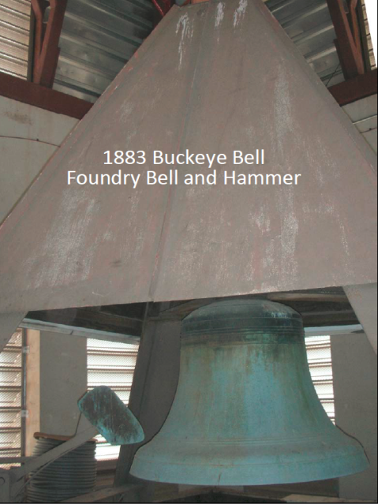
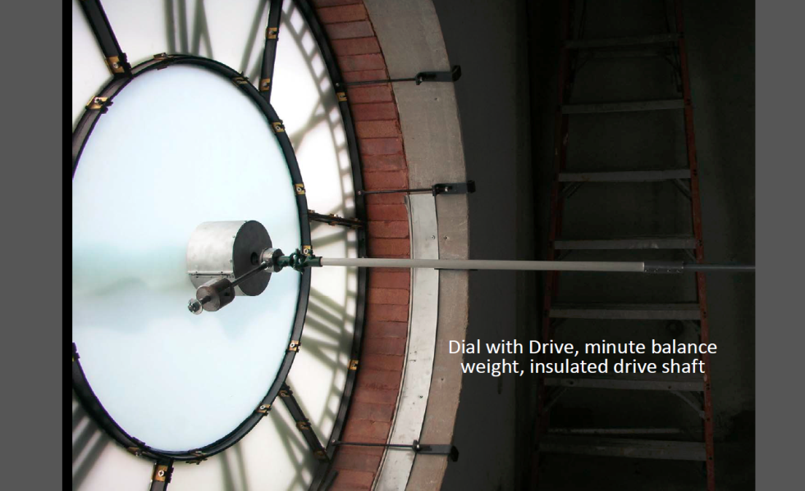
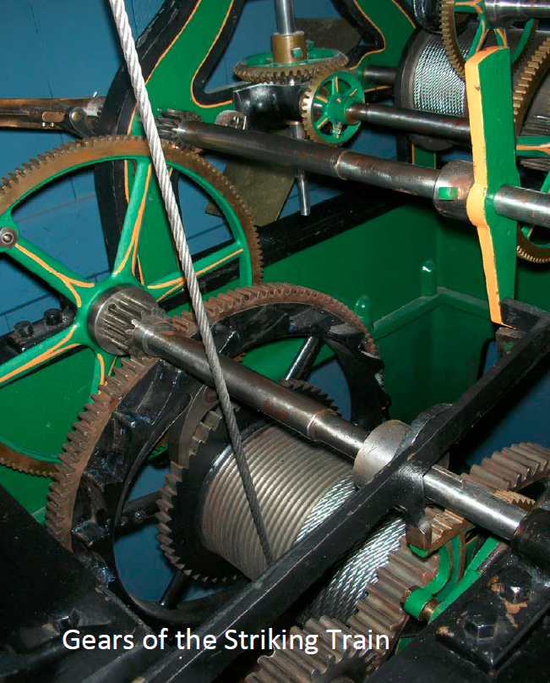
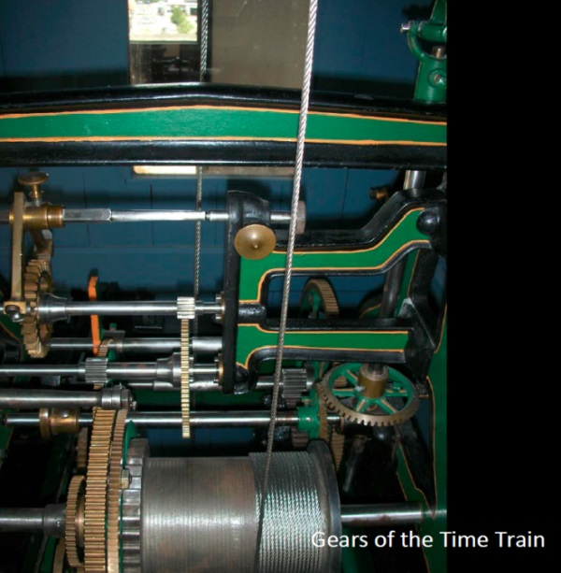
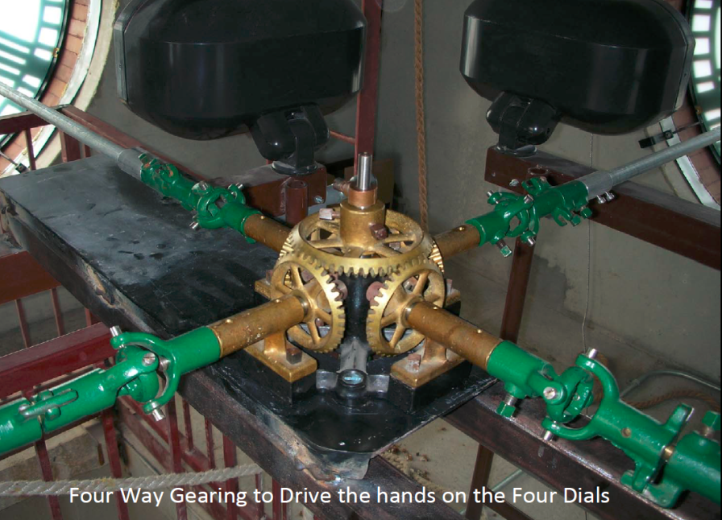
Seth Thomas Mechanical Clock - 1876
MechSE Department helped restore the clock – it had not actually worked for about 30 years. In part because the 1876 wood hour and minute hands had warped and jammed against each other
Restoration: 2002 - 2009

Slide 8
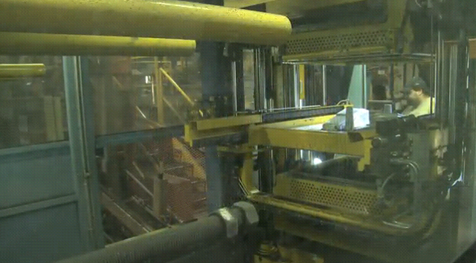
Horizontal Automatic Sand Casting
Vertical or Horizontal Mold Making Machines
200 to 600 parts/hr
Patterns and cores placed in by robotic device
Horizontal Molding Machine
video

Slide 9
Investment Casting (Lost Wax Process)
A pattern made of wax is coated with a refractory material to make mold, after which wax is melted away prior to pouring molten metal
"Investment" comes from a less familiar definition of "invest" - "to cover completely," which refers to coating of refractory material around wax pattern
It is a precision casting process - capable of producing castings of high accuracy and intricate detail
Lost Wax Video

Slide 10
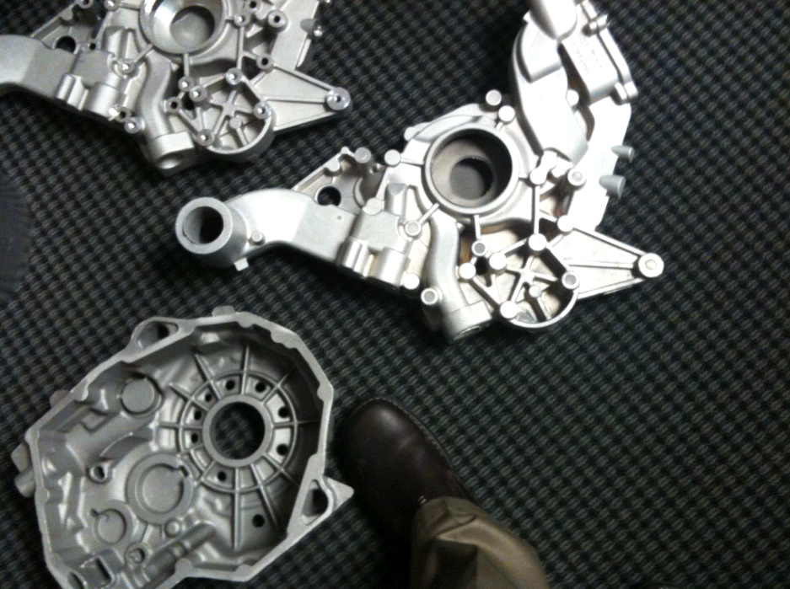
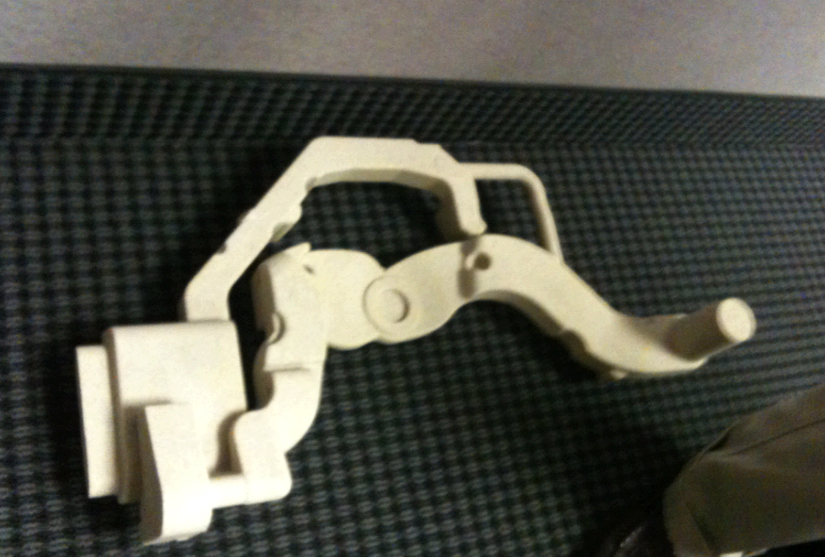
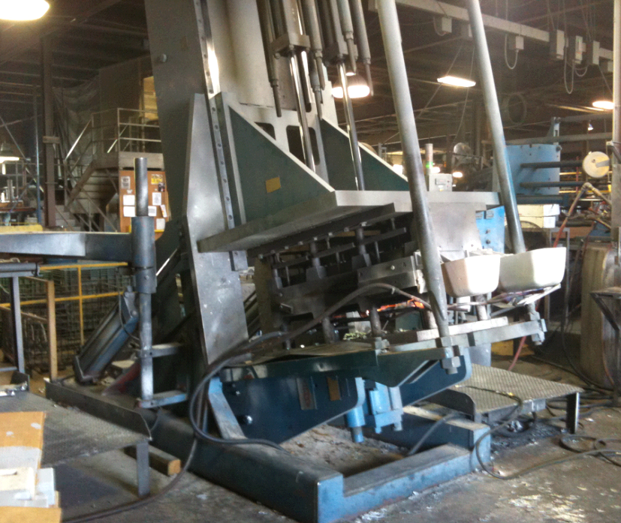
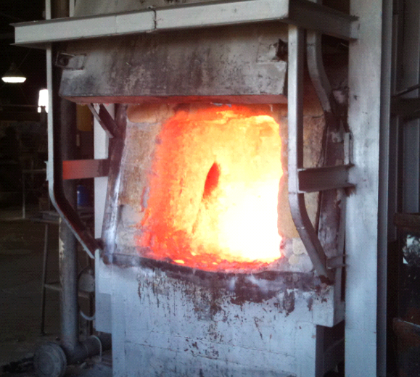
Permanent Mold Casting

Slide 11
Product Design Considerations
Geometric simplicity that allows for shrinkage and reduces the need for cores.
Reduce sharp angles by rounding corners and reducing stress concentrations areas that may cause hot tearing and cracks.
Increase draft angles (interior and exterior). Minimums:
Draft = 1° for sand casting
Draft = 2° to 3° for permanent mold processes

Slide 12
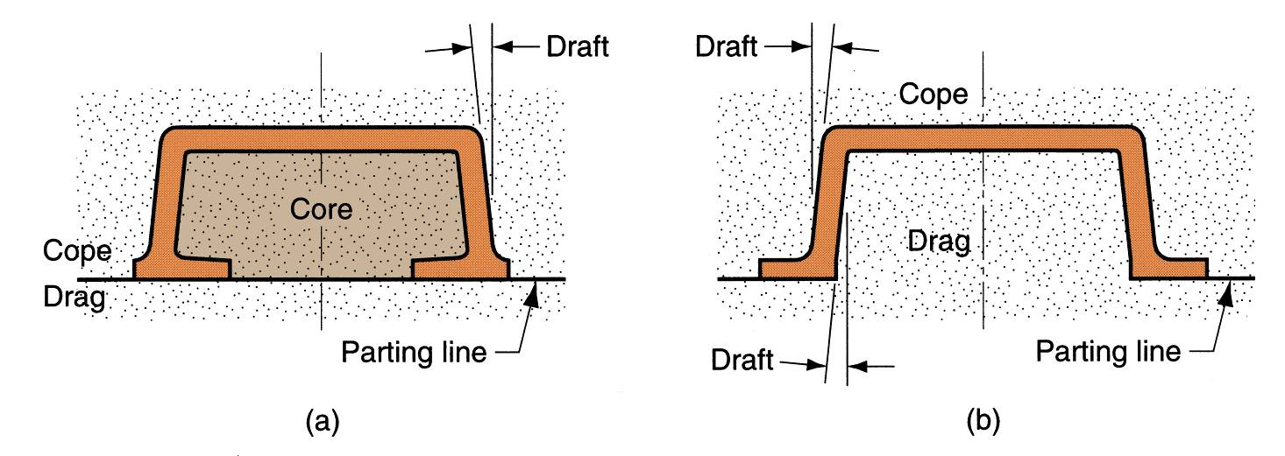
Draft
Minor changes in part design can reduce need for coring
Design change to eliminate the need for using a core: (a) original design, and (b) redesign.

Slide 13
Product Design Considerations - Cont
Dimensional Tolerances and Surface Finish:
Sand casting: poor dimensional accuracies and finish
Die casting and investment casting: better dimensional accuracies and finish
Machining Allowances:
Additional material, called the machining allowance, is left on the casting in those surfaces where machining is necessary

Slide 14
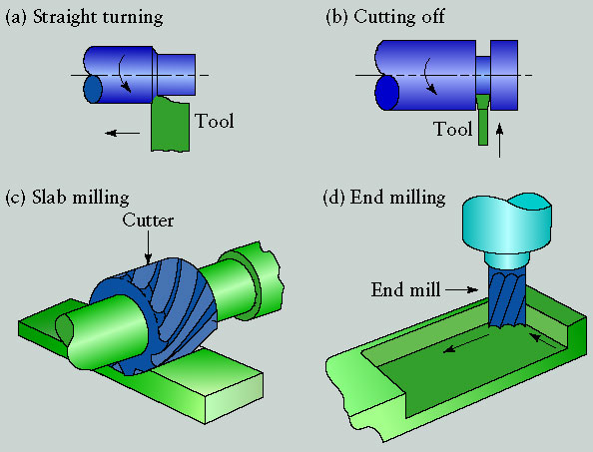
Introduction to Machining
Common Machining Operations
Aka: Material Removal Processes
Kalpakjian

Slide 15
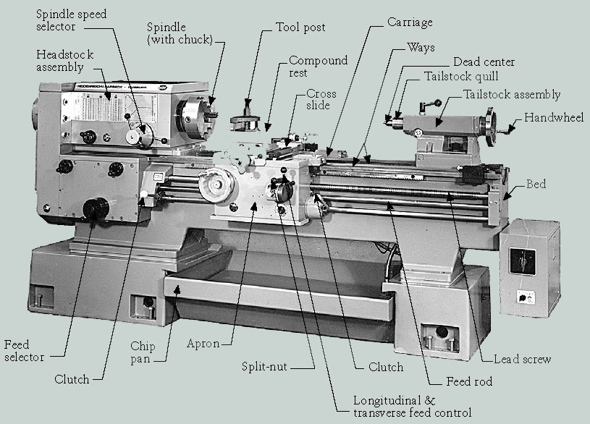
Parts of an “Engine” Lathe

Slide 16
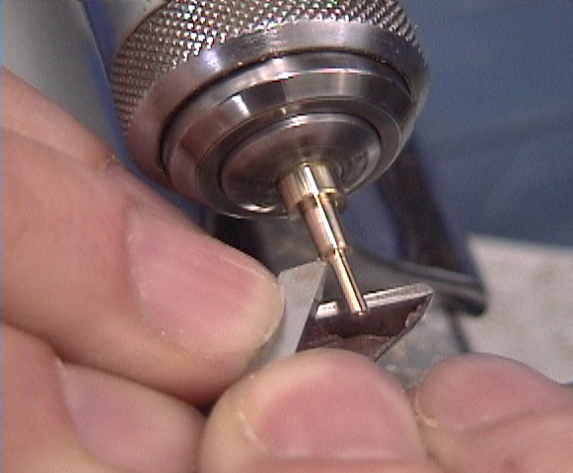
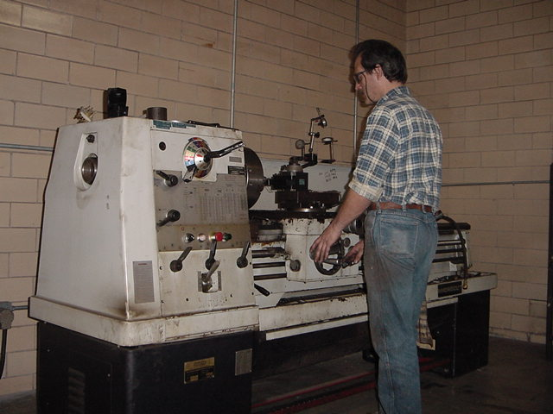
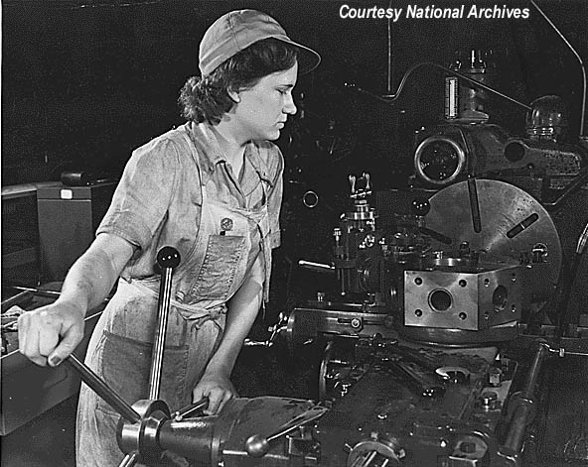
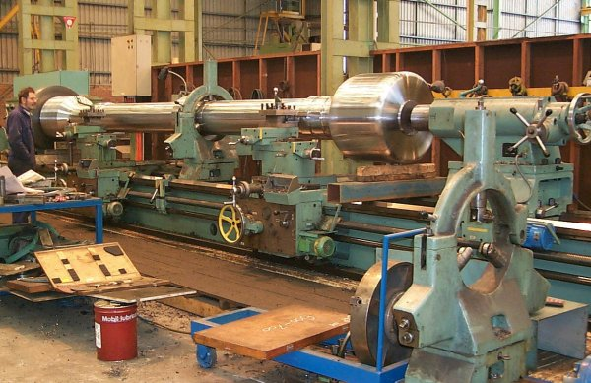
Watchmaker’s lathe
Typical “Engine” Lathe
www.ticktockpro.com
www.blazingtech.net
Turret Lathe
Big “Engine” Lathe

Slide 17
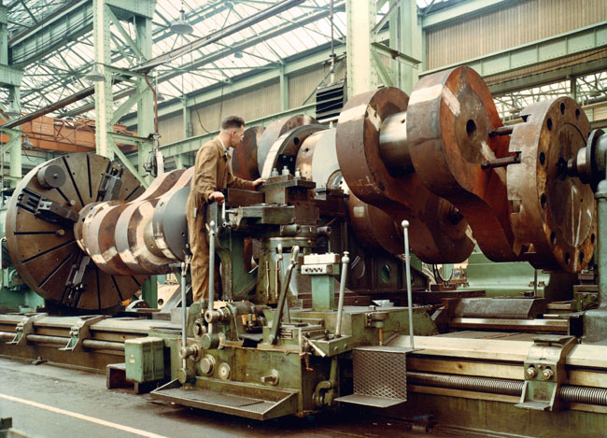
Really Big “Engine” Lathes
www.practicalmachinist.com

Slide 18
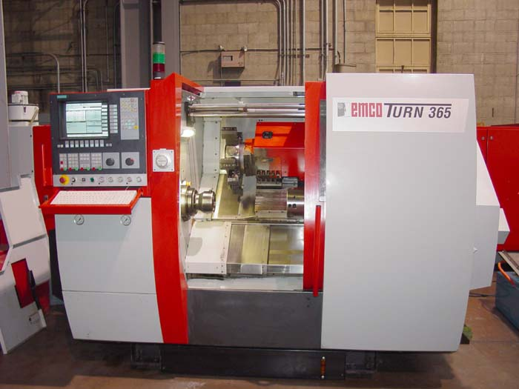
CNC Lathe: aka “Turning Center”
(carriage is mounted toward back, “upside down”)
www.machineryvalues.com
CNC = Computer Numerical Control (features are machined to size and location by a computer)

Slide 19
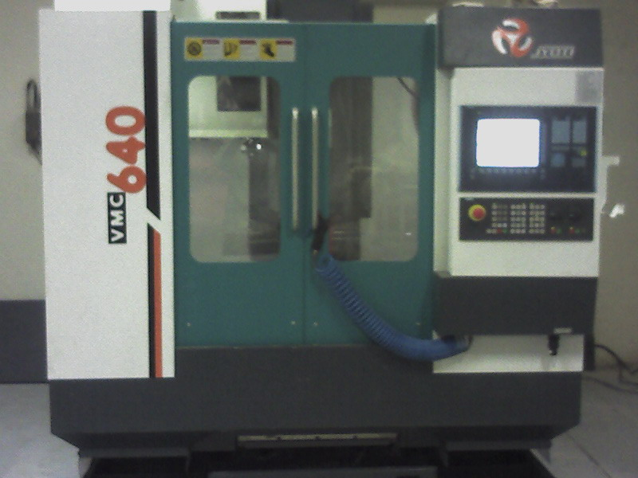
CNC MILL or “Machining Center”
Links:
CNC machining engine block from solid
Milling an Impeller

Slide 20
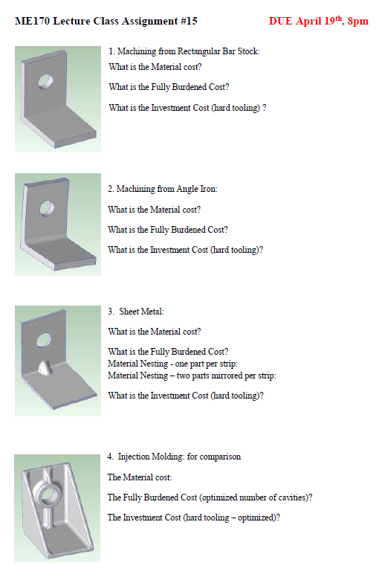
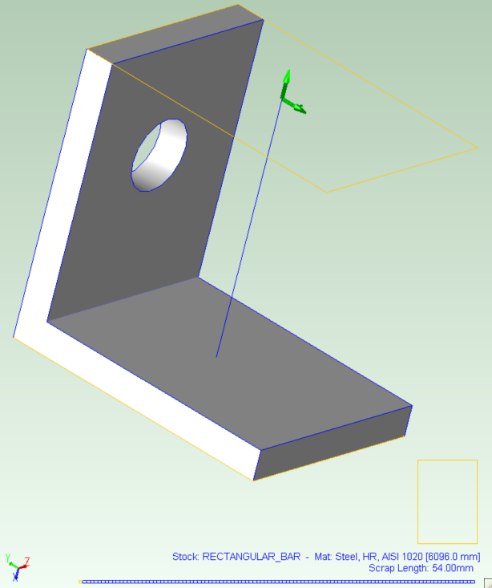
This first design assumes that we are going to machine this from a rectangular solid bar of steel. When we open this in aPriori and select stock machining the system will find the smallest enclosing rectangle and look for standard bar stock that fits. The blue writing to the bottom shows the stock selected and the number of parts, and waste, that that can be made form this. This is all automatic.
Sharp corners indicate machining process

Slide 21
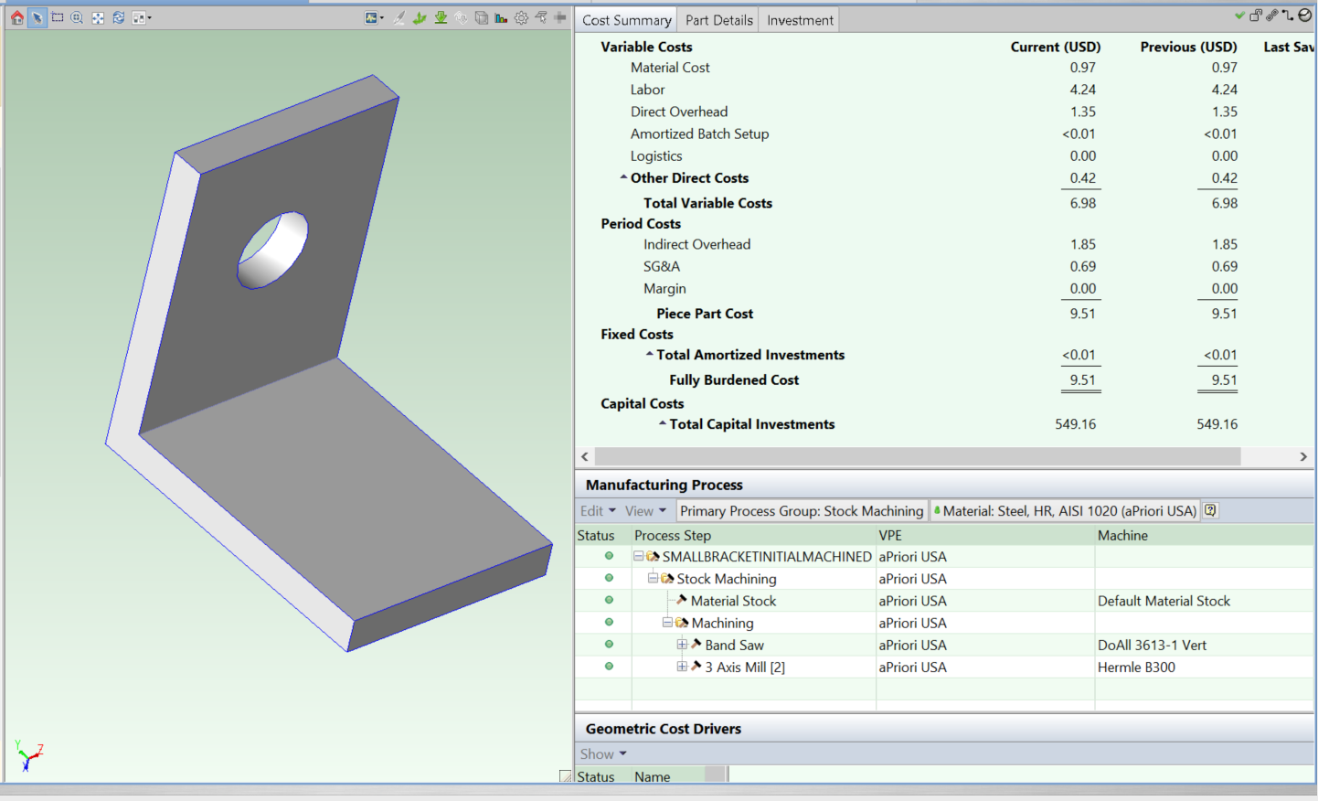
Here is the result after opening the part in aPriori, selecting stock machining, and letting the system use its defaults. The VPE (Virtual Production Environment) is the digital model of the factory and notice that its located in the USA. The material chosen is 1020 HR (hot rolled) steel – a common low cost steel. In the Manufacturing Process window, aPriori shows the processes used to create each feature – the Band Saw is used to cut off each piece from the bar and the 3 axis mill is used to drill the hole.

Slide 22
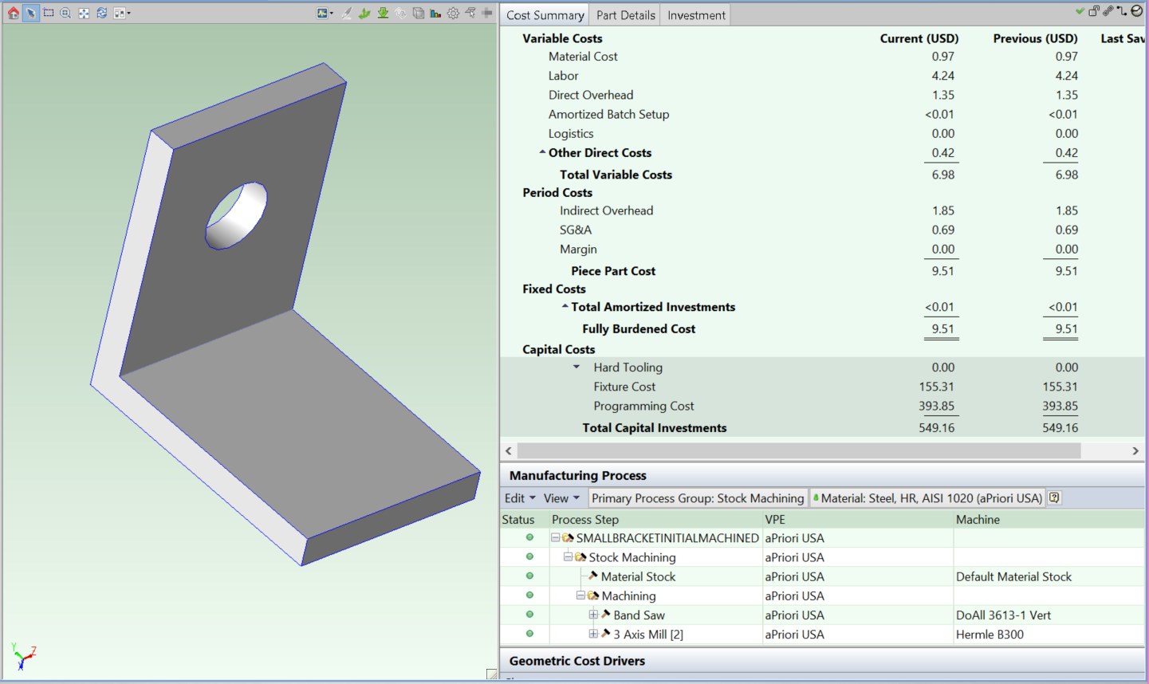
So, how much does it cost to make the part this way? The information is given in the “Cost Summary” window. In the assignment I ask for the Material cost, the Fully Burdened Cost, and Investment Cost (or Total Capital Investments). The Fully Burdened Cost is the cost to make each part plus the factory burden which includes all the machine overhead costs, (admin salary etc), utilities, and the amortized cost of the initial investments, or “Investment Cost”. The amortized cost is the cost amortized, or shared out, across the product life (default of 5 years). In other words, mathematically amortized investment cost is (Investment Cost)/(Annual Volume * Product Life)

Slide 23
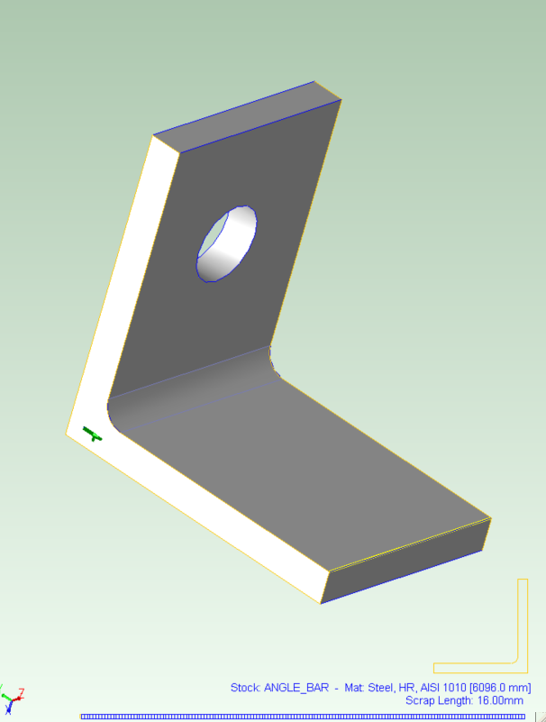
This 2nd part design assumes that perhaps a more economical way would be to start with a piece of stock the shape of the part, especially as it is a standard shape i.e. Angle iron. By selecting “Bar and Tube” process and angle bar stock we can explore this. Again, blue writing to the bottom shows the stock selected and the number of parts, and waste, that that can be made form this.
Round on inside edge, sharp on outside edge

Slide 24
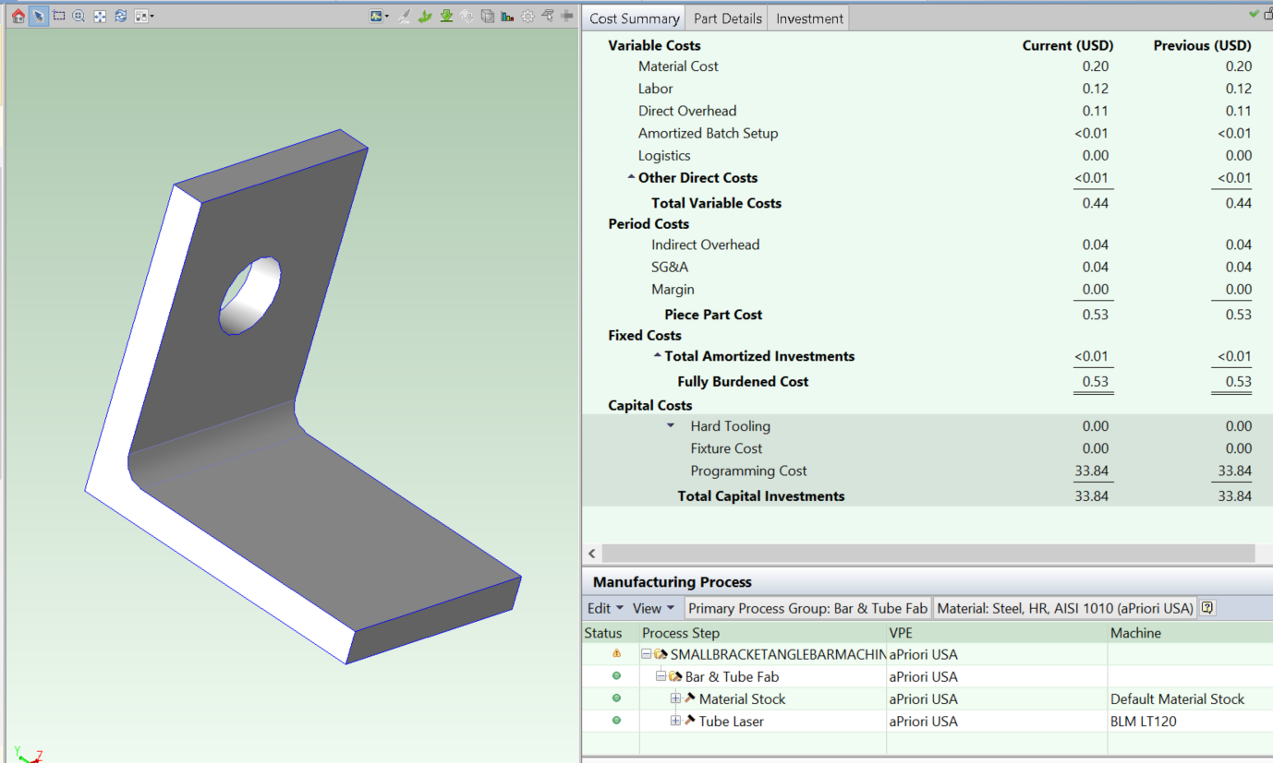
So, how much does it cost to make the part this way? Note that by designing it to match a standard stock shape, we have achieved a significant reduction in the cost to make this part. All the costs are lower. Not only is the cost per part much lower, but significantly the up-front investment cost is only $33 total, which may well be a big deciding factor in going this way!

Slide 25
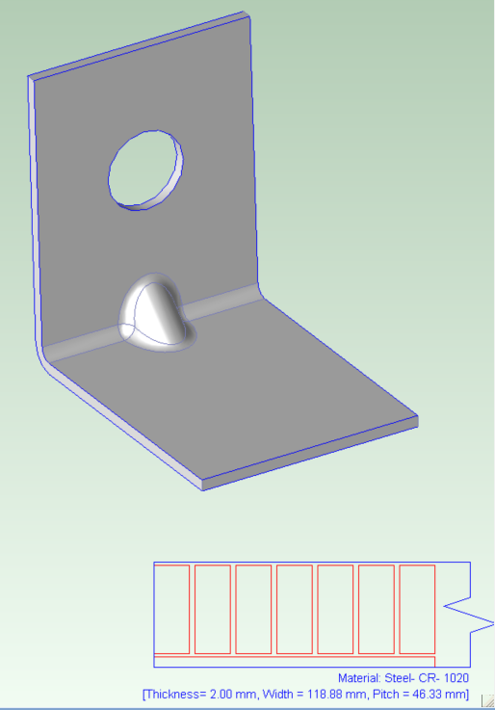
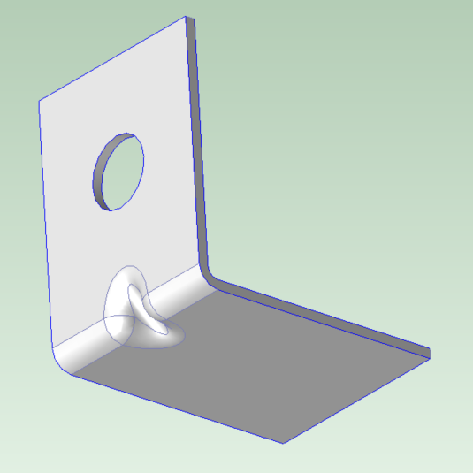
This 3rd part design takes the high volume consumer product approach, as expected of you in your Term Design projects. If its metal, then design it from sheet stock if you can! By selecting “Sheet Metal” process we can run it with a progressive die set and as long as we have high volume, cover the cost of the die set. Again, blue writing to the bottom shows the stock selected which in this case is a single strip of metal – one part per strip
Sheet stock must maintain shape continuity and have bend radii no less than the thickness
Underside showing “Bird Beak” feature to stiffen and use minimum thickness/material

Slide 26
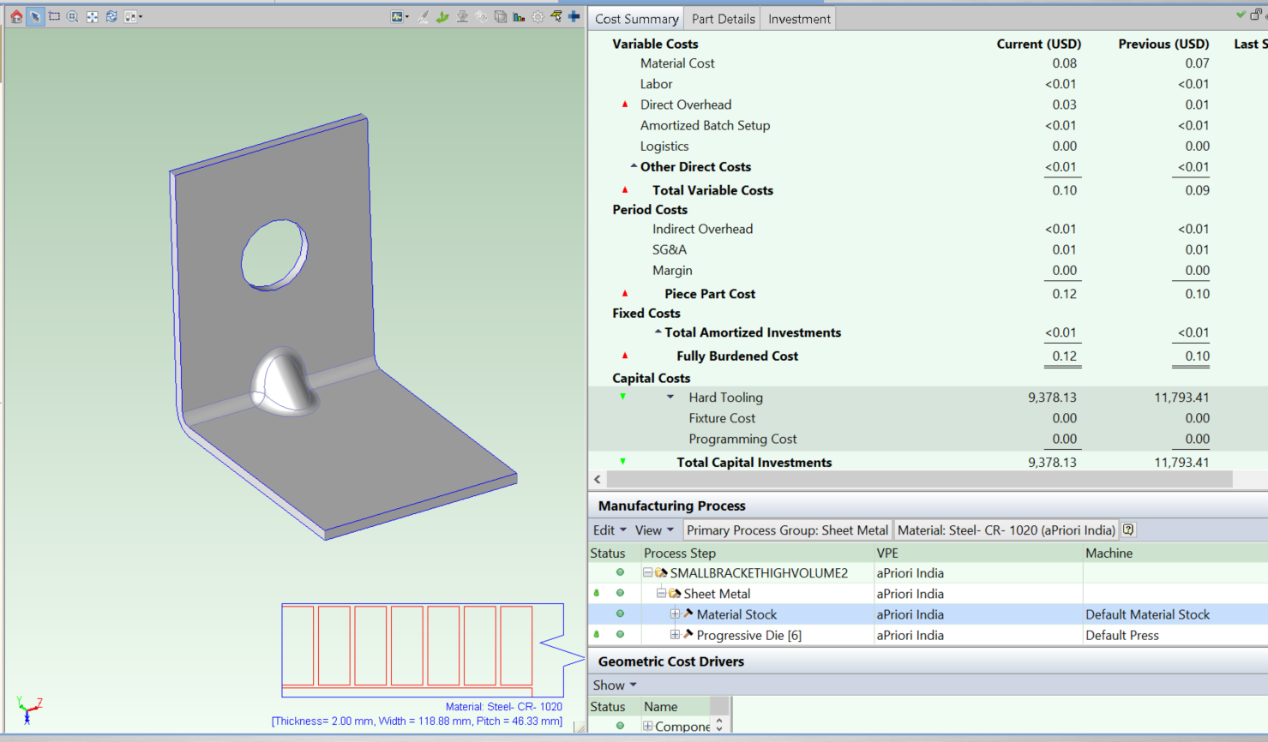
So, how much does it cost to make the part this way? The production volume is set to 1,000,000 over 5 years. By designing it as a sheet metal part we can take advantage of the high speed and low part cost inherent in sheet metal production. Now only $0.12 to make. The high investment cost in the tooling is amortized over 5 million parts so, as you can see, its less than $0.01 per part. However, it’s a risk and we have to perhaps borrow a large chunk of money up front to pay for the project.; large companies expect to make this investment and put money aside to “Tool up”. Also, this time you may note I chose a VPE in India as they are particularly good at low-cost high-quality sheet metal production.

Slide 27
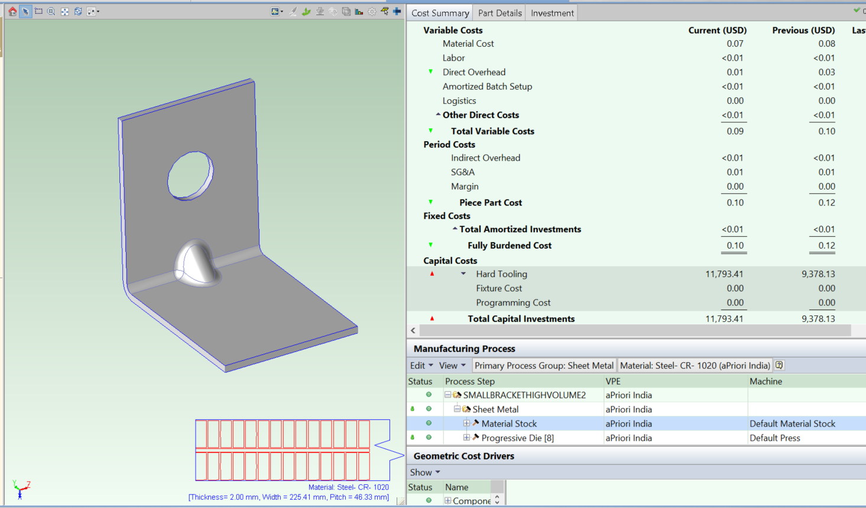
When design for manufacture high-volume consumer products we always have options on how many parts we make with each tool. Generally, the more we make in one go, the cheaper the part cost, but the higher the investment cost because the tooling (stamping dies in this case) are larger and more complex. So it’s worth exploring the common trick of making two mirrored parts at once (common to have a left and right part in automotive applications). Note the stock diagram shows two at a time on the strip of metal entering the progressive die machine. Note the tooling is more expensive but the part cost has gone down even further. In the question, in the assignment, I just ask for the final number (i.e. here) for the investment cost.

Slide 28
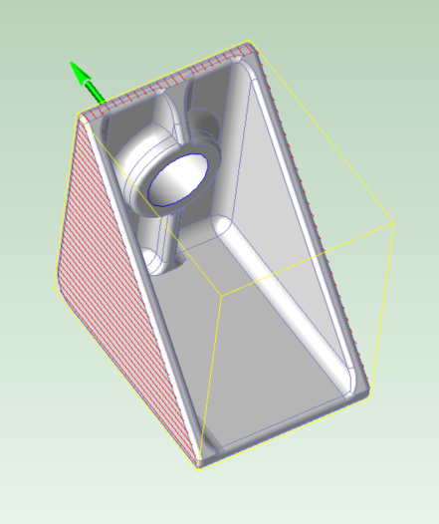
This 4th and final part design investigates the other main high volume consumer product approach, Injection Molding. We use the default plastic ABS and the same high production numbers of 1,000,000 parts annual volume and 5 year product life. The red markings show the parting line in the mold that aPriori assumes with the green arrow indicating the assumed parting direction.
Plastic is inherently not as strong as metal so we have to add strength through changes in geometry with stiffening ribs etc.
We must also maintain constant wall thickness of between 1-3mm to keep cooling time in the mold low and avoid defects/distortion during cooling

Slide 29
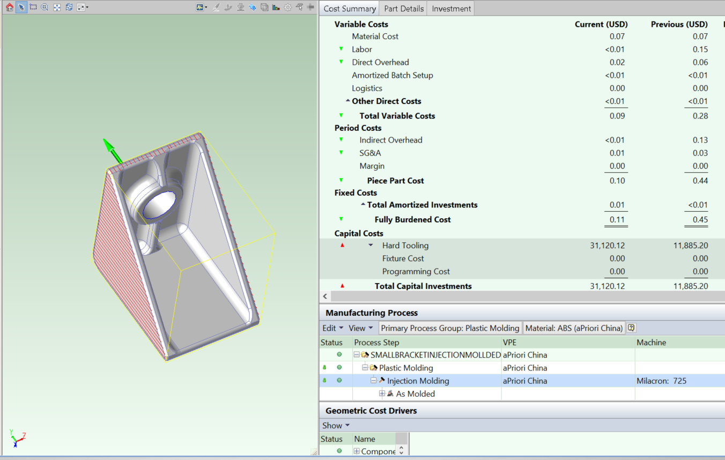
So, how much does it cost to make it out of plastic using the injection molding process? This time I chose China as the VPE and I also went to the process setup options and chose a multi-cavity mold. I asked the system to optimize this to give the lowest fully burdened cost. So, as you see, the part cost is much the same as sheet metal, a little higher which may surprise you. The tooling investment is signifacntly higher, so when people say, plastic is always cheapest, they are ill informed! ☺.

